Slide 1
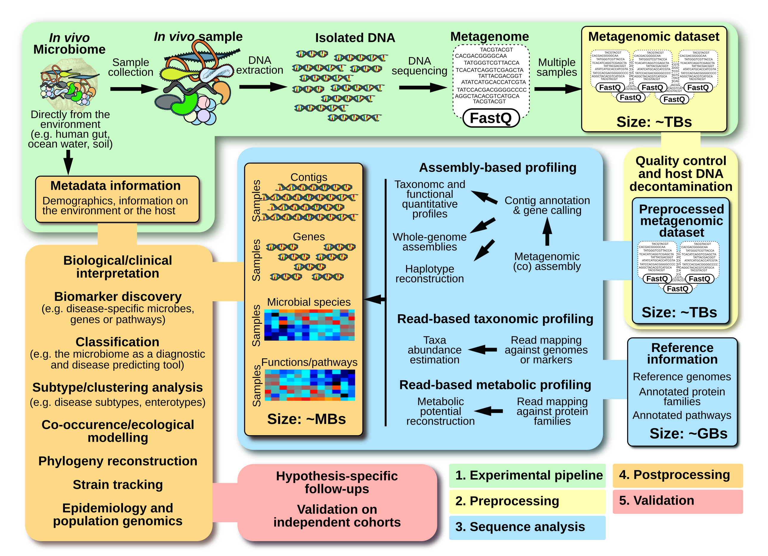
Quince et al Nat. Biotech http://rdcu.be/vMYk

Slide 2
Taxonomic and functional classification of metagenome sequences
Chris Quince

Slide 3
Introduction
What is in my community and what can they do?
Most of this talk is focused on read based methods but in principle could be applied to contigs
There is a distinction between methods that aim to classify every read and those that only aim to profile the community
Taxonomic and functional classification only differ in the choice of database

Slide 4
Overview
Databases
Search algorithms
Software

Slide 5
Taxonomic/functional classification
Classification (supervised learning) problem of identifying to which of a set of categories a new observation belongs
Requires a training database and an algorithm for comparing against that database
Database is just a set of sequences with labels
Query is a sequence too
Taxonomic classification just means that database has a hierarchical labelling
Functional databases are often hierarchical too

Slide 6
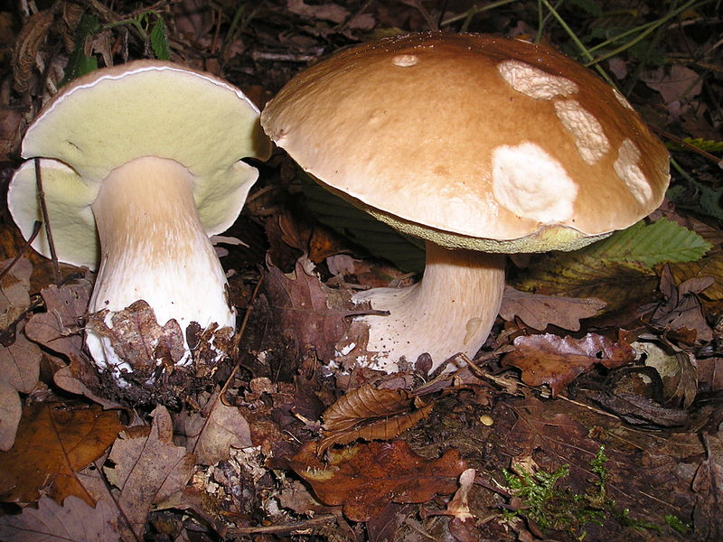
What is a Taxonomy?
Classic hierarchical classification:
Kingdom, Phylum, Class, Order, Family, Genera, Species e.g. Fungi, Basidiomycota, Agaricomycetes, Agaricomycetidae, Boletales, Boletaceae, Boletus, Boletus edulis
Taxonomy = system for classification Phylogeny = evolutionary history represented as a tree

Slide 7
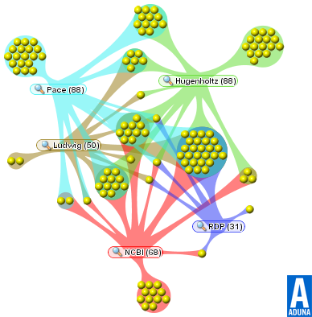
Taxonomy is an arbitrary labeling..

Slide 8
Metagenome taxonomy databases
Usually based on NCBI Taxonomy possibly with some curation
Either consists of whole genomes or the whole of the NR/NT
Trade-off between quality and comprehensivity

Slide 9
Functional databases
These comprise generic databases that attempt to contain every functional protein family e.g. Pfam http://pfam.xfam.org/
Or they may be curated for a specific class of functions e.g. CAZy http://www.cazy.org/
Discuss COGs and the KEGG in a bit more detail…

Slide 10
Clusters of orthologous genes (COGs) http://www.ncbi.nlm.nih.gov/COG/
Each COG consists of individual orthologous genes
COGs can be used in phylogenies and are strongly related to function:
e.g. COG0001 Glutamate-1-semialdehyde aminotransferase
Currently (2003) there are 4873 COGs from 66 genomes
Extensions include group specific e.g. archaeal COGs and unsupervised eggNOGShttp://eggnog.embl.de/version_4.0.beta/

Slide 11
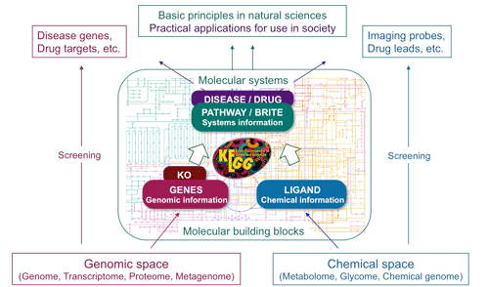
Kyoto Encyclopedia of Genes and Genomes (KEGG) database
KEGG
Sequence
Gene
KO number
Module
Pathway

Slide 12
Kegg module: M00123 Biotin biosynthesis
Biotin

Slide 13
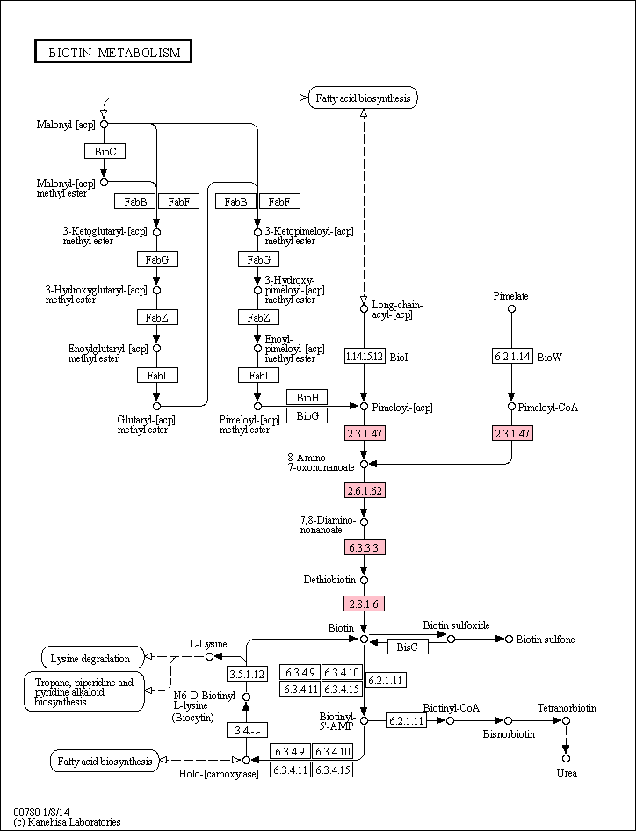

Slide 14
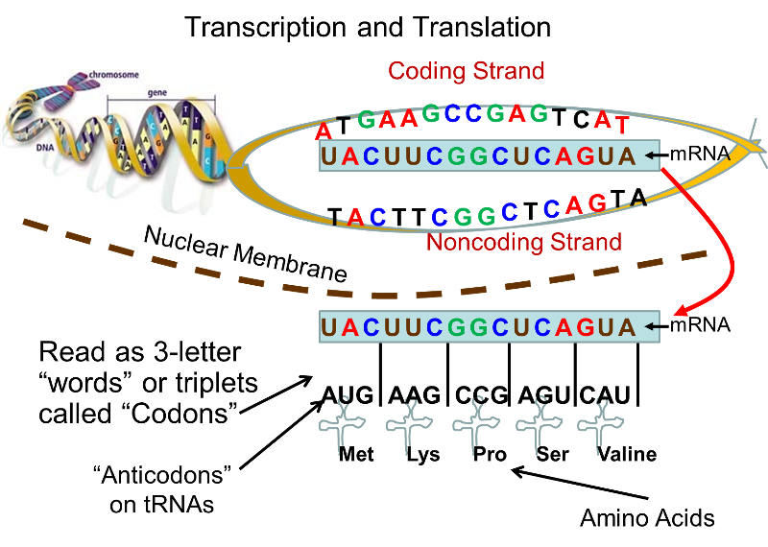
Searches are performed in either nucleotide or amino acid space…

Slide 15
Sequence search algorithms
Four basic approaches:
Alignment or Sequence homology
Mapping
Kmers
Hidden Markov models (HMMs)

Slide 16
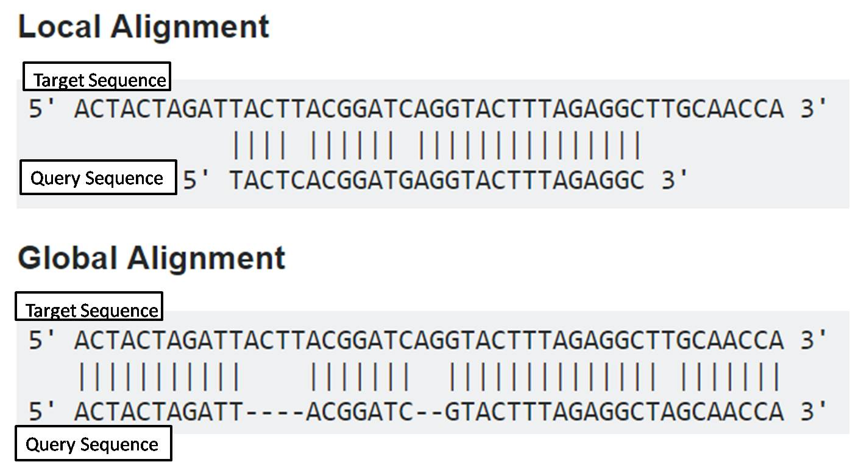
Sequence alignment is sensitive can find distant relationships between query and target
Also precise can distinguish between two very similar targets
Drawback alignment is slow!
Examples of alignment search algorithms are Blast, Diamond, Rapsearch, vsearch (nucleotide only)

Slide 17
Homology distances
Once sequences are aligned metrics are calculated to indicate similarity to reference sequences
Edit distance
E value
describes the number of hits one can "expect" to see by chance when searching a database of a particular size
Typically top N hits are returned
ACTGCTTTAGGGGG -> database
ACT- CTTAAGGGGT -> query
Edit distance = 3

Slide 18
Mapping
Realisation that we do not always need searches that can find distant relationships
If we restrict the search to a everything within a threshold of similarity and only return hits better than that then we can use efficient algorithms e.g. Burrows-Wheeler transform
Examples of mappers are:
BWA
Bowtie2
Restricted to nucleotide comparisons?
Precise but not sensitive

Slide 19
Kmers
A "k-mer" is a word of DNA that is k long
Homologous sequences share kmers
Comparing kmer composition is a fast way to search queries against a database
Drawback lacks precision

Slide 20
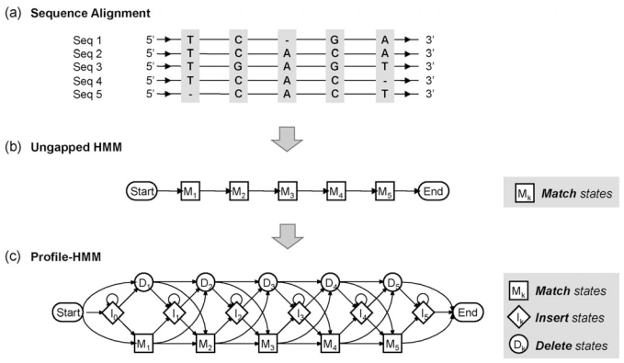
Hidden Markov Models (HMMs)

Slide 21
Mappers
Sequence alignment
Precision
kmers
HMMs
Sensitivity

Slide 22
Taxonomic classification/profiling software
All software for metagenome read classification consists of some variant on one of these algorithms and a database:
Homology search: MEGAN
Kmer based: Kraken
FM - index: Centrifuge
Profilers same principle but use database of marker genes e.g. MetaPhlan2 or mOTU hence cannot classify every read

Slide 23
MEGAN – Metagenome analyser
Matches against the NR using Diamond blastx
Lowest common ancestor (LCA) algorithm based on NCBI taxonomy
Kingdom Phylum … Family
Bacteria Actinobacteria … Bifidobacteriaceae
Species - Hits
Genus
Bif. longum 98%
Bifidobacterium
Bif. bifidum 97%
Bif. dentium 96%
Cut off – 95%
G. vaginalis 91%

Slide 24
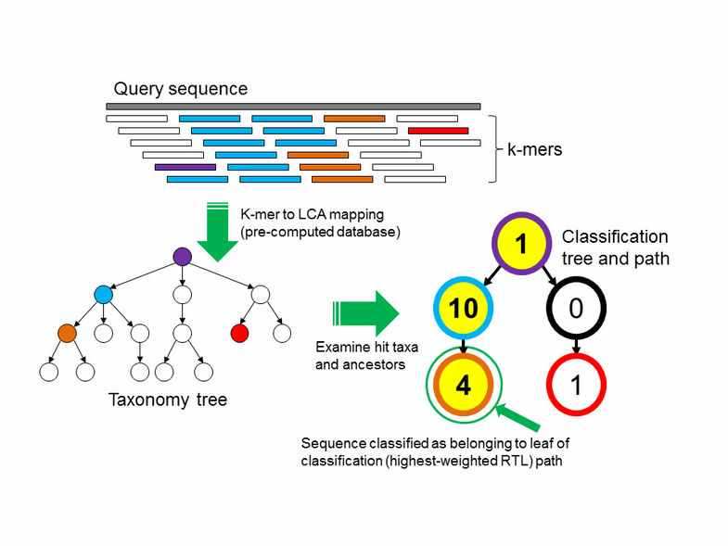
Kraken
Kmer based default 31bp
Default database comprises RefSeq 2014

Slide 25
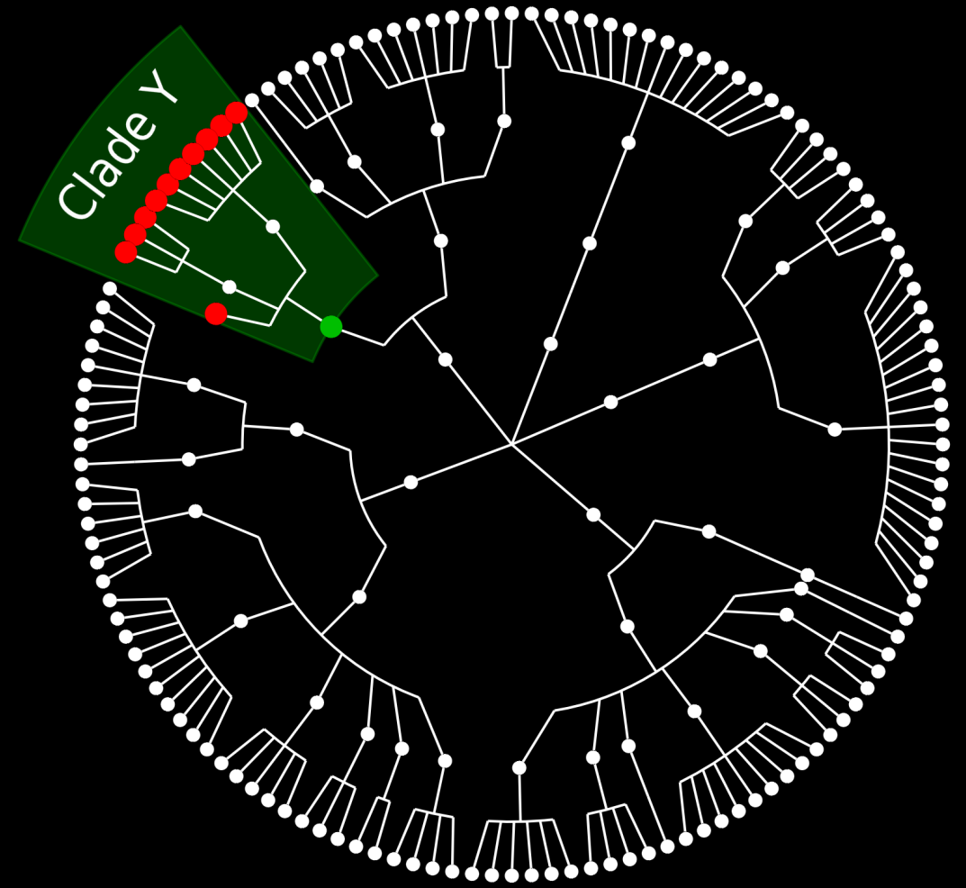
MetaPhlAn: the basic idea
X is a unique marker gene for clade Y
Gene X
IDEA
Pre-identify markers from reference genomes
Use markers as proxy for taxonomic clades in shotgun metagenomics
18k
15k
THE INPUT
~25.000 genomes (bacteria, archara, fungi, viruses)
~1/10 of genomes are final, ~9/10 draft
~7,100 species (excludes incomplete annotations, spp., etc.)
THE RESULTING DATABASE
~15M total unique marker genes
~1M “most representative” unique marker genes
180±45 markers per species (200 fixed max)
Quasi-markers used to resolve ambiguity in postprocessing
12k
Method: ChocoPhlAn
9k
6k
Number of microbial organisms in RefSeq
3k
0k
2003
2004
2005
2006
2007
2008
2009
2010
2011
2012
2013

Slide 26
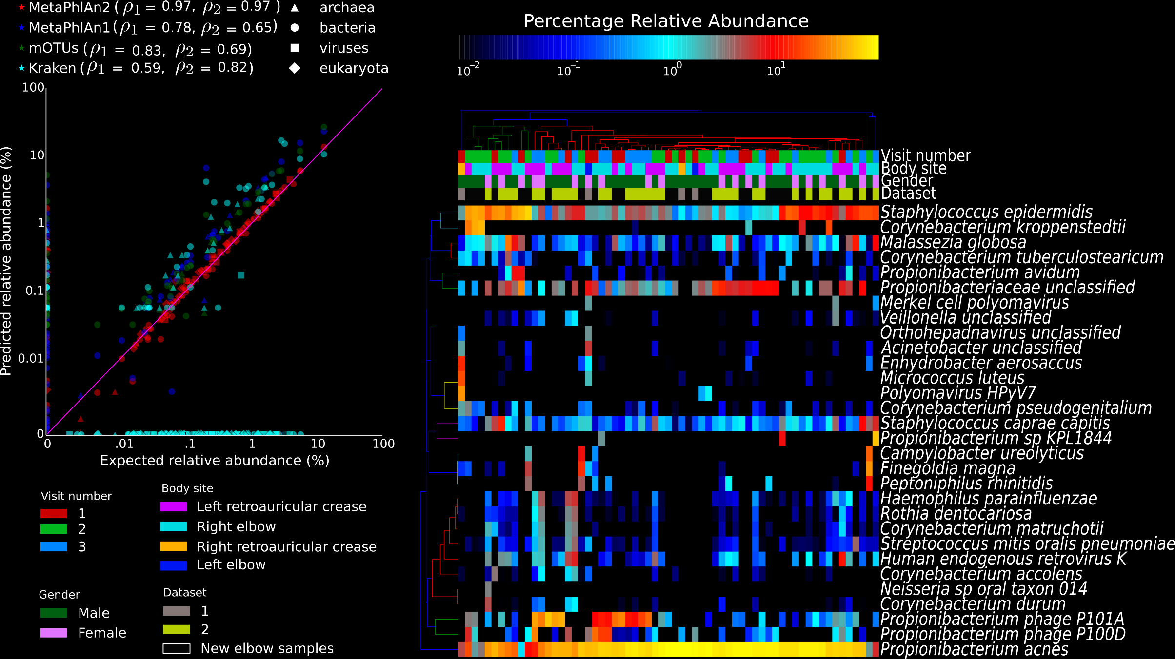


MetaPhlAn2: trans-kingdom profiling using marker genes
Segata et al, Nature Methods 2012
Truong et al, Nature Methods, 2015
Microeukaryotes
Viruses
Tin Truong

Slide 27
False positives
The challenge with taxonomic labelling to strain/species level of reads is false positives due to shared genes
Classic example plague on the New York subway! (Afshinekoo et al. Cell 2015):
“A smaller proportion (12%) of the detected taxa with species-level identification were known pathogens, including Yersinia pestis (Bubonic plague) and Bacillus anthracis (anthrax).”
Map reads onto genomes and look for consistent coverage – integrated into SPARSE (Zhou et al. 2018)

Slide 28
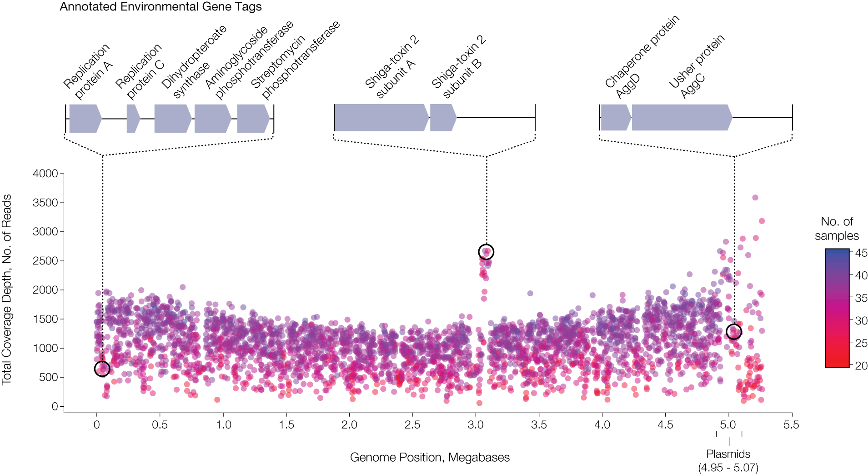
Loman et al. JAMA 2013 “A Culture-Independent Sequence-Based Metagenomics Approach to the Investigation of an Outbreak of Shiga-Toxigenic Escherichia coli O104:H4”

Slide 29
Functional profiling
Same principles apply to functional profiling communities except now the searches have to be distant homology or HMM and in amino acid space
MEGAN generates Kegg profiles too
HUMAnN: The HMP Unified Metabolic Analysis Network (Abubucker et al. PLoS Comp Biol 2012)

Slide 30
How to find a COG?
We use RPS-BLAST against NCBI COG database
RPS Blast: Reversed Position Specific Blast
searches a query sequence against a database of profiles
What is a BLAST profile?
PSI-BLAST (Position-Specific Iterative Basic Local Alignment Search Tool) derives a position-specific scoring matrix (PSSM) or profile from the multiple sequence alignment of sequences
The PSSM captures the conservation pattern in alignment and stores it as a matrix of scores for each position in the alignment-highly conserved positions receive high scores and weakly conserved positions receive scores near zero
Capable of detecting distant sequence similarities

Slide 31
Summary
Profiling effective way to summarise community structure and compare communities
Does not provide high resolution picture linking organism to function (requires assembly…)
Always be cautious of results:
Presence of gene does not imply expression
Correlation does not imply causation

